Slide 1
SECURE DATA HIDING IN IMAGES USING
STEGANOGRAPHY
CAPSTONE PROJECT
Presented By: NEERUMALLA JAHNAVI
Student Name : NEERUMALLA JAHNAVI
College Name & Department : BHARATH UNIVERSITY- CSE

Slide 2
OUTLINE
Problem Statement
Technology used
Wow factor
End users
Result
Conclusion
Git-hub Link
Future scope

Slide 3
Problem Statement
1.Data security and confidentiality are critical concerns in digital communication, requiring innovative ways to hide sensitive information.
2.Traditional encryption methods are effective but can be easily detected, making steganography a preferable alternative for covert data transmission.
3.This project focuses on hiding a secret message within an image by modifying pixel values without significantly altering the image’s appearance
4.The message can only be retrieved using a correct passcode, ensuring that unauthorized users cannot access the hidden data.
5.The goal is to demonstrate a simple yet effective steganographic approach for secure communication using Python and OpenCV.

Slide 4
Technology used
1.OpenCV(cv2) - Used for reading, modifying, and writing image files.
2. Python - The core programming language for implementing the logic.
3. Steganography – A technique for hiding secret messages within images by modifying pixel values.
4. File Handling & OS Module – To save and open encrypted images.

Slide 5
Wow factors
1.The project allows hiding a secret message within an image without making significant changes to its appearance.
2. Password-based decryption ensures security, making it harder for unauthorized users to extract the message.
3.The image itself acts as a key to store and retrieve secret messages , making it an innovative and practical approach for secure communication

Slide 6
End users
1. Cybersecurity Enthusiasts - For learning and implementing secure communication techniques.
2. Journalists & Activists – To transmit sensitive information safely.
3. Government & Military Personnel – For secure messaging and data hiding.
4. Students & Researches – Interested in exploring digital steganography.

Slide 7
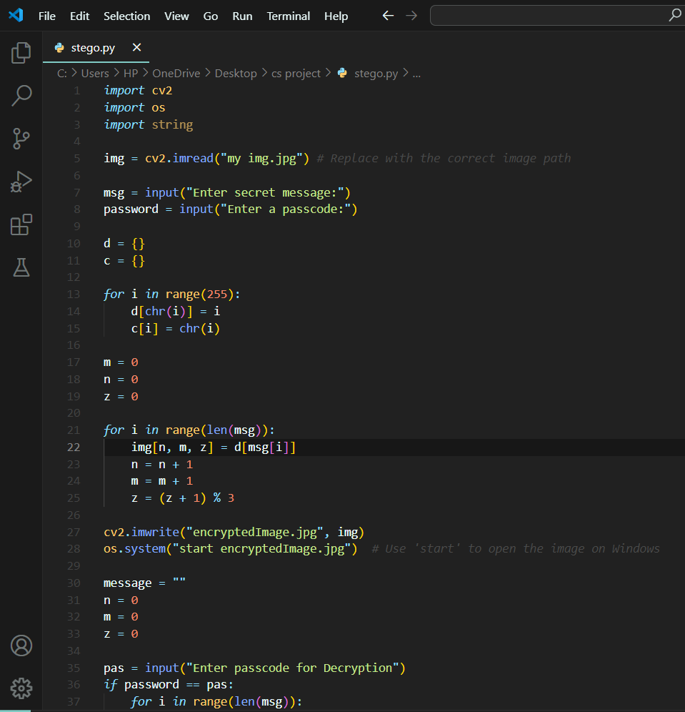
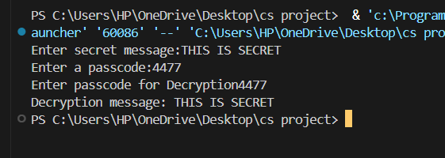

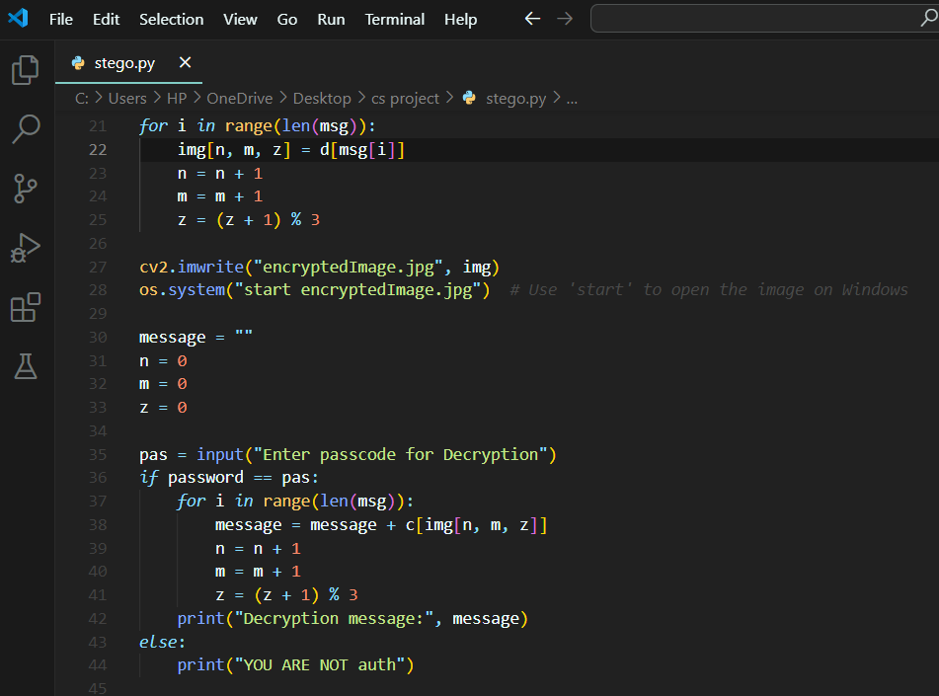
Results
ENCRYPTED IMAGE

Slide 8
Conclusion
1. Steganography is a powerful technique for secure communication, and this project demonstrates its basic implementation using Python and OpenCV.
2. The integration of encryption with images makes it a unique and effective way to store and share secret messages.
3. Although basic, this project lays the groundwork for advanced image steganography techniques.

Slide 9
GitHub Link:
https://github.com/JAHNAVI-0706/STEGANOGRAPHY-PROJECT.git

Slide 10
Future scopE
1. Increase Security – Implements AES or RSA encryption before embedding message for added protection.
2. Enhance Capacity – Improve the algorithm to store longer messages without noticeable image distortions.
3. GUI Development – Create a user-friendly interface for non –technical users.
4. Support for Different Images Formats – Extend compatibility to PNG,BMP and GIF files.
5. Noise Reduction Techniques- Use LSB(Least Significant Bit) modification to make the changes even less detectable.

Slide 11
THANK YOU

